Slide 1

FOOD AND EGGS SPOILING DETECTION

Slide 2
AGENDA
INTRODUCTION
COMPONENTS
CIRCUIT DIAGRAM
SYSTEM WORKFLOW
PROGRAM
PROBLEM ARISES DURING DEPLOYMENT
ADVANTAGES AND DISADVANTAGES
FUTURE ENHANCEMENTS

Slide 3
INTRODUCTION
The spoilage detection system is a cutting-edge technology designed to enhance food safety and quality control by detecting spoilage in food items, particularly eggs. It utilizes a combination of sensors, data processing algorithms, and user interfaces to monitor spoilage indicators such as gas emissions and weight deviations in real-time. By providing early alerts and feedback to users, the system helps mitigate the risk of consuming contaminated or spoiled food, reducing food waste and promoting sustainable consumption practices.

Slide 4
COMPONENTS
Gas Sensor
Load Cell
Hx711
Buzzer and light
Arduino Uno
LCD Display
Breadboard with Jumper Wires

Slide 5
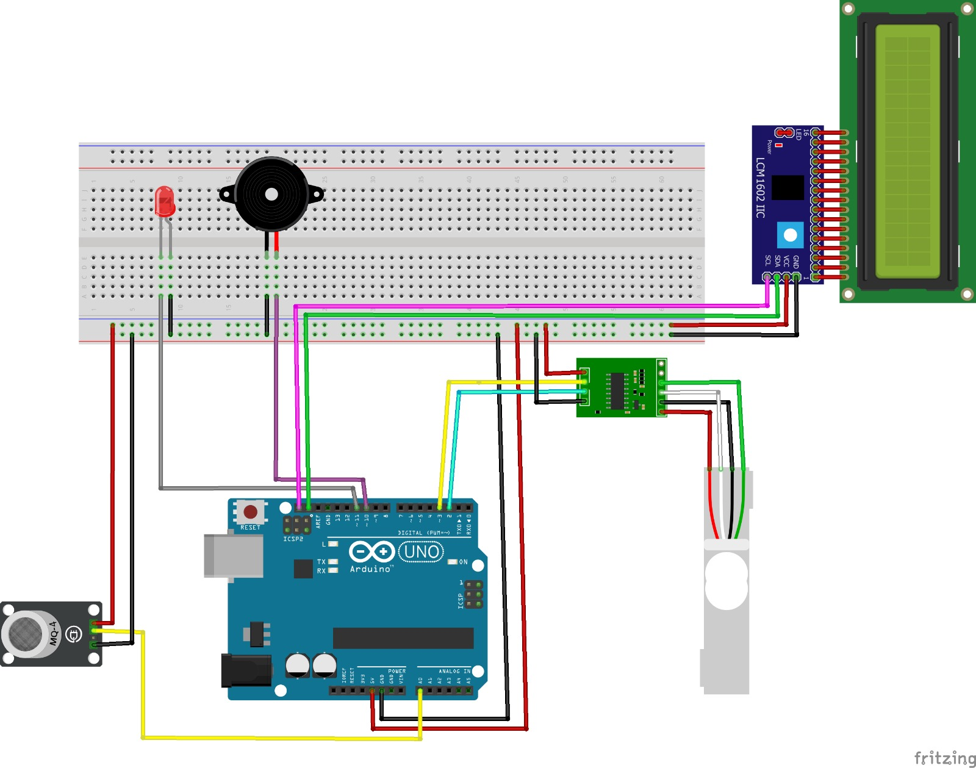
CIRCUIT DIAGRAM

Slide 6
SYSTEM WORKFLOW
Data Acquisition: The gas sensor, load cell, and HX711 continuously collect data on spoilage gases and egg weight.
Data Processing: The Arduino Uno processes the sensor data using programmed algorithms to analyze spoilage indicators, such as gas concentrations and weight deviations.

Slide 7
Spoilage Detection: Based on the analysis of sensor data, the Arduino Uno determines the freshness status of food items and generates feedback signals to alert users to potential spoilage.
Feedback Generation: The Arduino Uno activates the buzzer and light to provide audible and visual alerts, while the LCD display updates users on the freshness status of food items in real-time.

Slide 8
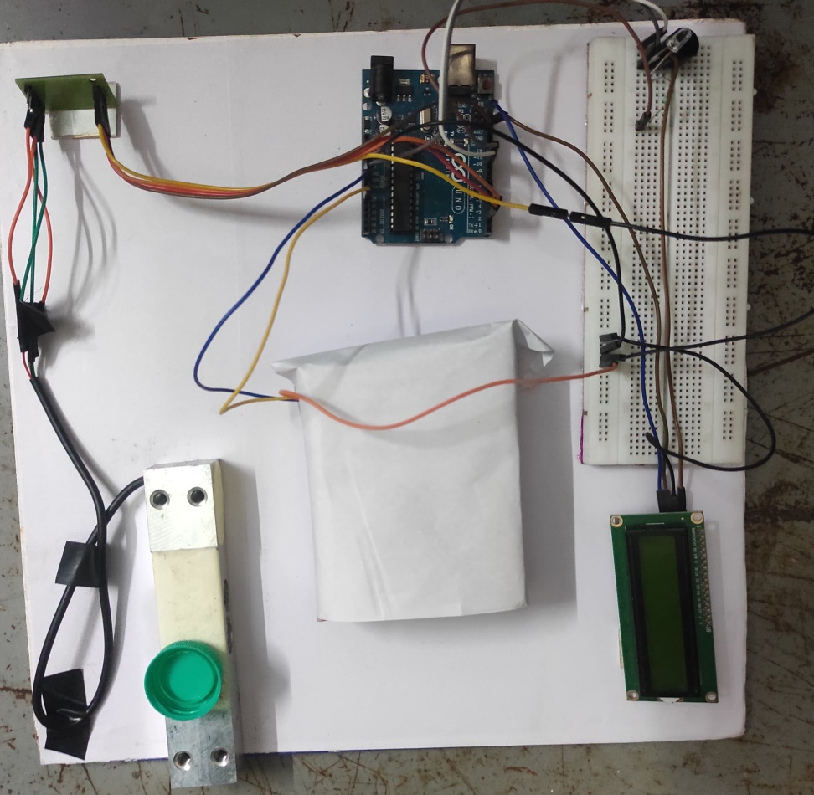
PROJECT IMAGE
BUZZER
LED
ARDUINO UNO
BREADBOARD
JUMPER WIRES
GAS SENSOR
LCD DISPLAY
HX711
LOADCELL

Slide 9
PROGRAM
#include <Wire.h>
#include <LiquidCrystal_I2C.h>
#define MQ_PIN A0
#define LED_PIN 11
#define BUZZER_PIN 10
const int DOUT_PIN = 2;
const int SCK_PIN = 3;
const float LOAD_CELL_CALIBATION = 10009.0;
const float MAX_WEIGHT_THRESHOLD = 0.10; // Maximum acceptable weight
const int MAX_GAS_THRESHOLD = 110; // Maximum acceptable gas value
LiquidCrystal_I2C lcd(0x27, 20, 4); // set the LCD address to 0x27 for a 16 chars and 2 line display

Slide 10
SETUP FUNCTION
void setup()
{
Serial.begin(9600);
lcd.init();
lcd.backlight();
lcd.setCursor(0, 0);
lcd.print("Gas value: ");
lcd.setCursor(0, 1);
lcd.print("Weight: ");
scale.begin(DOUT_PIN, SCK_PIN);
scale.set_scale(LOAD_CELL_CALIBATION);
pinMode(LED_PIN, OUTPUT);
pinMode(BUZZER_PIN, OUTPUT);
scale.tare();
}

Slide 11
LOOP FUNCTION
void loop(){
float currWeight = scale.get_units();
int gasValue = analogRead(MQ_PIN);
lcd.setCursor(10, 0);
lcd.print(gasValue);
lcd.print(" ");
lcd.setCursor(8, 1);
lcd.print(currWeight, 2); // Display weight with 2 decimal places
lcd.print(" g ");
if(currWeight <= MAX_WEIGHT_THRESHOLD && gasValue <= MAX_GAS_THRESHOLD)
{
digitalWrite(LED_PIN, LOW); // Turn off LED
noTone(BUZZER_PIN); // Turn off buzzer
lcd.setCursor(0, 3);
lcd.print("Good: ");
}
else{
digitalWrite(LED_PIN, HIGH); // Turn on LED
tone(BUZZER_PIN, 1000); // Sound buzzer
lcd.setCursor(0, 3);
lcd.print("Spoiled: ");
}
delay(5000);
}

Slide 12
PROBLEM ARISES DURING DEPLOYMENT
Sensor Calibration Issues:
Problem: Improper calibration of sensors, such as the load cell, may lead to inaccurate readings and unreliable detection of spoilage.
Solution:
Ensure thorough calibration of sensors before deployment, following manufacturer guidelines and best practices.
Implement periodic calibration checks to verify sensor accuracy and recalibrate if necessary.
Implement continuous calibration mechanisms to monitor and adjust the load cell's readings over time, compensating for any drift or changes in its performance

Slide 13
INITIAL STATE SENSITIVITY
Problem: Before placing any weight on the load cell, its initial state (zero weight) should be calibrated accurately. Any deviation from this initial state could lead to incorrect weight measurements and affect the system's ability to detect spoilage accurately.
Solution:
Before uploading the program to the Arduino Uno check any weight place on the Load cell if weight is placed it will take and upload the program.

Slide 14
ADVANTAGES
Early Spoilage Detection
Improved Food Safety
Reduced Food Waste
User-Friendly Interface

Slide 15
DISADVANTAGES
Limited Detection Scope
Sensor Calibration Challenges
Dependency on Power Supply
Initial Setup Complexity

Slide 16
FUTURE ENHANCEMENTS
Integration of Multi-Sensor Fusion
Adoption of Advanced Machine Learning Techniques
Enhancement of User Interface and Interaction
Differentiating Egg Sizes
Auto-Threshold Setting

Slide 17
COST OF PROJECT
ARDUINO UNO | 472
GAS SENSOR | 157
LOAD CELL | 350
RX711 | 120
BUZZER | 87
LED | 2
BREADBOARD | 120
TOTAL | 1310

Slide 18


